Slide 1
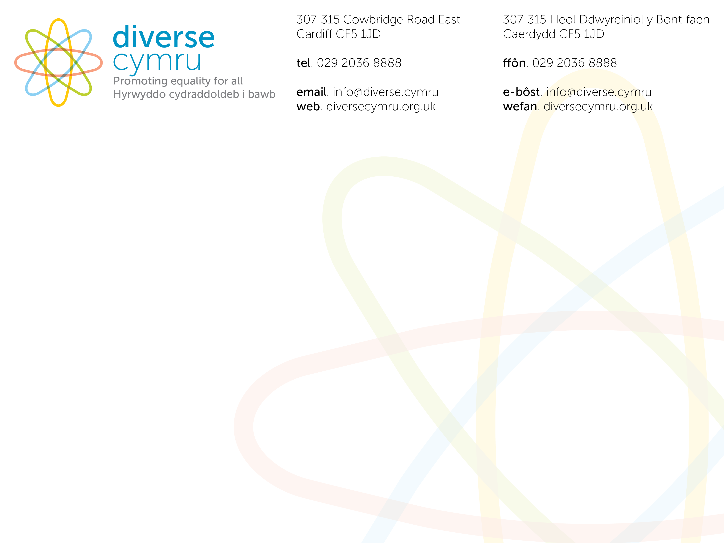
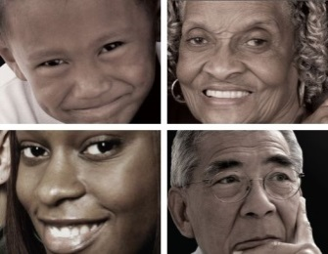

IMPROVING CULTURAL COMPETENCE IN THE WORKPLACE
Black, Asian and Minority Ethnic
Cultural Competence Certification Scheme
Cultural Competency Certification Scheme Overview
Black, Asian and Minority Ethnic (BAME / BME ) includes for example, African, Caribbean, Asian, Eastern European, Irish, Gypsy, Roma and Traveller communities, with particular regard to the perceived cultural differences of these groups.

Slide 2


Scheme Overview
Overview Outline
    The Need
    Impact and Challenges
    How the Scheme Works
    Benefits and Outcomes
    Your Role
    Any Questions
How well do we support and work with ethnically diverse communities
How do we treat and interact with people who are perceived as different to us?

Slide 3

The NEED
The need stems from the recognized inequality in the services provided to the Black, Asian and Minority Ethnic service users accessing heath services as compared to non Black, Asian and Minority Ethnic service users
  Black people 40% more likely to be turned away when seeking help from mental health services
  Black patients in mental health institutions 29% more likely to be forcibly restrained
  Black people 49% more likely to be placed in seclusion
As has been highlighted in a range of reports and research data, although inequalities in mental health services for the Black, Asian and Minority Ethnic community have been acknowledged as a real concern for decades, these disparities still remain and rather than getting better in many instances are in fact getting worse
Address Disparities faced by Black, Asian and Minority Ethnic communities
The potential Impact of Unconscious Bias and the lack of Cultural Competence in the Workplace

Slide 4


The Impact of a lack of cultural competence and Unconscious Bias
Influences:
Who we employ
How much we involve and listen to people who are different
How we design services and projects
How we deliver services
Which impacts on:
Team/individual working practices (how we treat one another)
Leadership – Management approaches
Lack of consultation and engagement
Leading to INEQUITY IN SERVICE PROVISION and DELIVERY
The Challenges of achieving cultural competence
Growing number of different cultures
Sharp and ever-increasing demand for services
Operating within tight financial constraints.
Needing greater awareness, knowledge, understanding and sensitivity of cultural difference

Slide 5

How the Scheme Works
The Black, Asian and Minority Ethnic
Cultural Competence Certification Scheme
A Positive Way Forward
Funded by WAG - Endorsed by the RCPsych- Certified by UKIED
Scheme History Highlights
2016 – Launch of Cultural Competency Toolkit
2018 – Launch of Certification Scheme (Mental Health)
2020 – Additional WAG funding to expand Certification Scheme
2022 – Working with 90+ workplace areas across Wales

Slide 6
How the Scheme Works
Evidence Based approach focuses on supporting organisations, workplaces and practitioners to improve cultural competency through workplaces making incremental practical changes to workplace practice where necessary
Provides Awareness Raising - Cultural Competence and Unconscious Bias
Self Assessment of Cultural Competence Progress
Structure
Aims and Objectives
To proactively address the inequality faced by Black, Asian and Minority Ethnic Individuals accessing services in Wales
To be achieved through the provision of practical assistance to organisations, workplaces and practitioners
Taking note of the issues related to the potential of unconscious bias and a lack of cultural competency
Certification verification provided through an established accredited body, enables organisations to incrementally work towards providing excellent practical culturally appropriate person-centered services

Slide 7
How the Scheme Works
Awareness Raising Session - Outline
What are the needs, issues, barriers, challenges and considerations for people from Black, Asian and Minority Ethnic backgrounds accessing health services
Understanding of Black, Asian and Minority Ethnic Mental Health Inequalities and disparities (using Mental Health as an Example)
2. What is Culture?
Cultural Awareness, Cultural Knowledge, Cultural Sensitivity, Cultural Competency
3. What is Unconscious Bias
4. What are the practical ways we can break down barriers and improve our practice to be more diverse and inclusive at a ground level for everyone
The Impact of Unconscious Bias and lack of culturally competent services
How to overcome Unconscious Bias and Improve Cultural Competence Practice
Summary and Questions

Slide 8

Module 1
Need, Issues, Barriers, Challenges and Considerations
  In seeking to ensure Black, Asian and Minority Ethnic communities an appropriate culturally competent Health service?

Slide 9


Module1 - Activity
Needs, Issues, Barriers, Challengers and Considerations
Opening Questions
Did the statistics surprise you?
1. Is there a need to address the disparities faced by the Black, Asian and Minority Ethnic community?
2. What are some of the
  Issues
  Barriers,
  Challenges and
  Considerations
Supplementary Question
What has your experience been as a Service Provider?

Slide 10
Module 2
Culture, Cultural Diversity and
Cultural Competence
  In seeking to ensure Black, Asian and Minority Ethnic communities an appropriate culturally competent Health service?

Slide 11
Module 2 - Activity
Culture, Cultural Diversity and Cultural Competence
Is it Important to know the demography of the community you provide services for?
What is Culture/Cultural Diversity?
2. What is Cultural Competence?
3. For a Culturally Competent service -
What are some of the:
  Challenges
  Benefits
  Need
How would you define your cultural background?
Is your workplace culturally competent?

Slide 12
Module 3
What is Unconscious Bias?
How do we treat and interact with people who are different to us?
  In seeking to ensure Black, Asian and Minority Ethnic communities an appropriate culturally competent Health service?

Slide 13
Module3 – Activity - Unconscious Bias
Opening Question
Does the Power of our subconscious mind surprise you?
What is unconscious bias?
How many pieces of information is our brain exposed to every second – How many of these do we consciously process
What percentage of day to day decisions are made by our unconscious mind
Do we stereotype - if so how do we stereotype
Where does our subconscious get its information from and what does it do with that information
Closing Question
What impact does our own Unconscious Bias have on the services that we deliver?

Slide 14
Module 4
What is the impact of unconscious bias and a lack of cultural competency in service delivery and what can we do?
  In seeking to ensure Black, Asian and Minority Ethnic communities an appropriate culturally competent Health services?

Slide 15


Module 4 - Activity
  The barriers and issues for people from Black, Asian and Minority Ethnic backgrounds accessing health services in seeking to Ensure Black, Asian and Minority Ethnic the delivery to communities of appropriate culturally competent services?
Next Steps
What are you now going to do as a result of what we have covered today?

Slide 16
How the Scheme Works
Self Assessment Process Outline
1. | Either Way Initial Contact
2. | Formal or informal contact prior to initial discussions between Diverse Cymru (DC) and interested parties
3. | Initial Discussion
4. | Face to face or telephone discussions between DC and potential participants providing general overview and explanation of the scheme
5. | Meeting with LEADS
6. | Detailed face to face discussion with identified lead individuals . Discussions to include in-depth explanation of the process, evidence template, participant requirements , completion of registration document, and start date – Agree Awareness Raising Training Dates
7. | Receive Signed Registration Document and Payment Participant Assigned certification process ID by DC
8. | All relevant documents including self assessment document made available to participants
9. | Date of first support visit arranged
10. | Thereafter Meetings / discussions at least every 2 months
11. | Support meetings /discussions to be held on a regular basis to assist with self assessment completion and evidence gathering
12. | DC Receive Completed Assessment Docs - Completed self assessment document sent to DC by Participant
13. | DC undertake initial Assessment - Date agreed for assessment visit if necessary
14. | DC Undertake Final Assessment
15. | Analysis report produced by DC for UK Investor in Equality and Diversity (UKIED) process verification
16. | UKIED External Verification and Recognition
17. | UKIED consider report and verify certification level, and send results and recognition certificate to DC
18. | Results and feedback
19. | DC advise participants of agreed certification level and provide certificate and feedback
20. | Ongoing Monitoring
21. | Reassessment and Revalidation takes place over an agreed time frame and frequency

Slide 17

Certification Scheme Assessment Areas and Assessment levels

Slide 18





Certificate of Cultural Competence Progress
xxxxxxx
Has been awarded the
Bronze Standard
Reflecting their developing cultural competence progress as part of Diverse Cymru’s Black, Asian and Minority Ethnic Cultural Competence Certification Scheme
This has been independently validated by the United Kingdom Investor in Equality and Diversity (UKIED).
Suzanne Duval, BEM, Manager, on behalf of Diverse Cymru
Dr Charles Willie, Assessor, on behalf of Diverse Cymru
Anthony Wilkes, CEO, on behalf of UKIED
Validated by
Endorsed by
Funded by
8 October 2021 - 8 October 2023
0810202101CW

Slide 19


Good Cultural Competence - The Benefits and Outcomes
Culturally competent services produce numerous benefits for the workplace /organisation, its patients and the community, including:
Social Benefits
  Increases mutual respect and understanding
  Increases trust
  Promotes inclusion of all community members
Service Benefits
  Improves patient data collection and monitoring
  Reduces care disparities
  Encourages more effective embedding of equality and diversity
Workplaces/ Organisations that are culturally competent have improved outcomes, increased respect and mutual understanding, and increased participation from the local community. Additionally, organisations that are culturally competent may have lower costs and fewer disparities.

Slide 20


Black, Asian and Minority Ethnic Cultural Competence Workplace Good Practice Certification Scheme
Cost of just £500 per workplace which includes free awareness training sessions for up to 24 participants
As much help as you need to achieve certification.

Slide 21


ANY QUESTIONS?

Slide 22
IMPROVING CULTURAL COMPETENCE IN THE WORKPLACE
Black, Asian and Minority Ethnic
Cultural Competence Certification Scheme

